Slide 1
Reducing Malnutrition by Introducing Moringa in Mare Brignol
Preventative and restorative approach

Slide 2
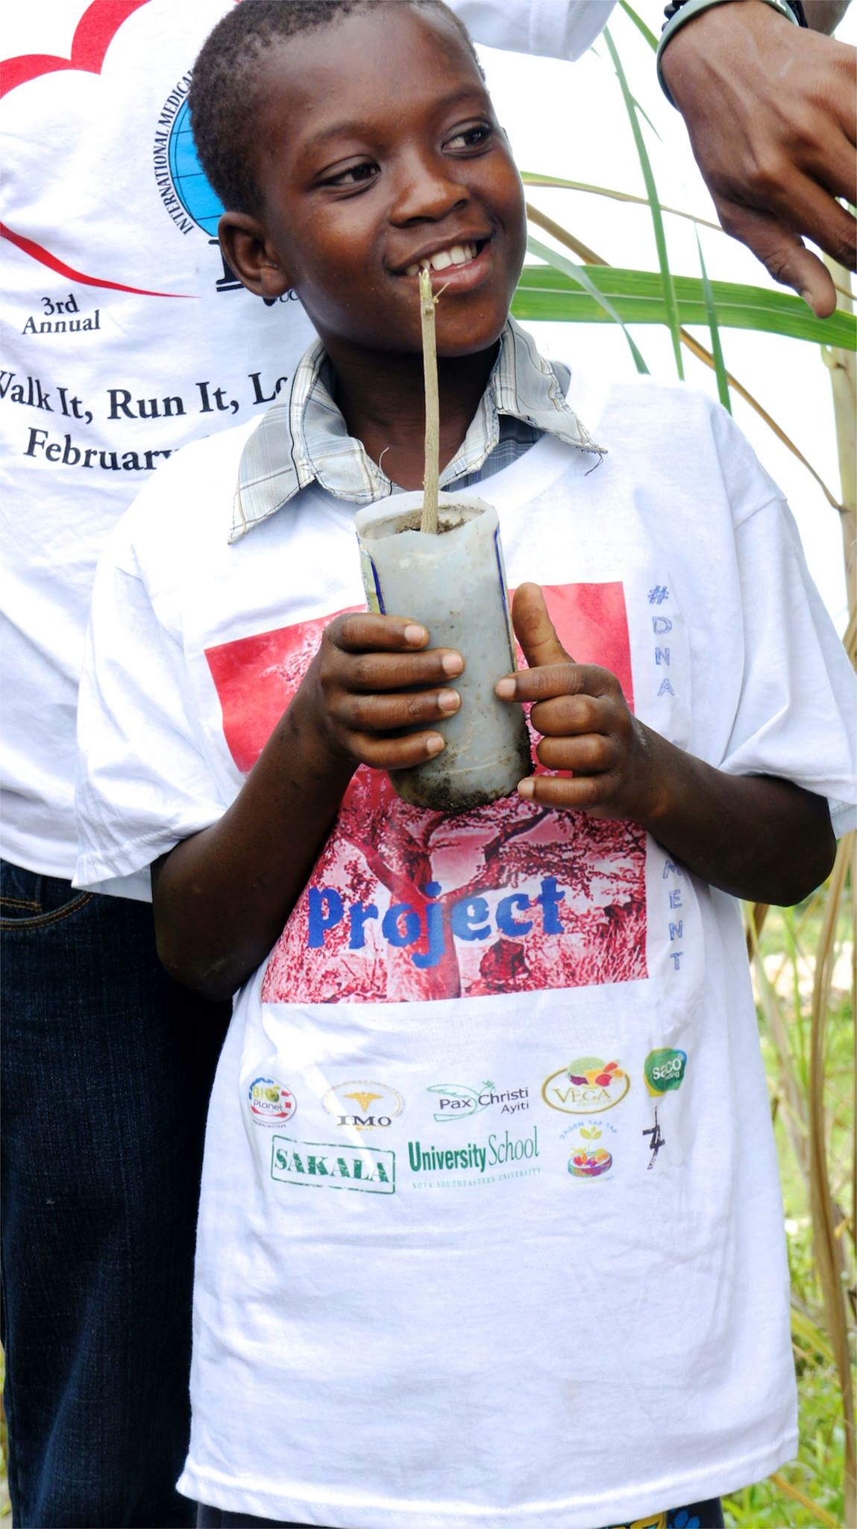
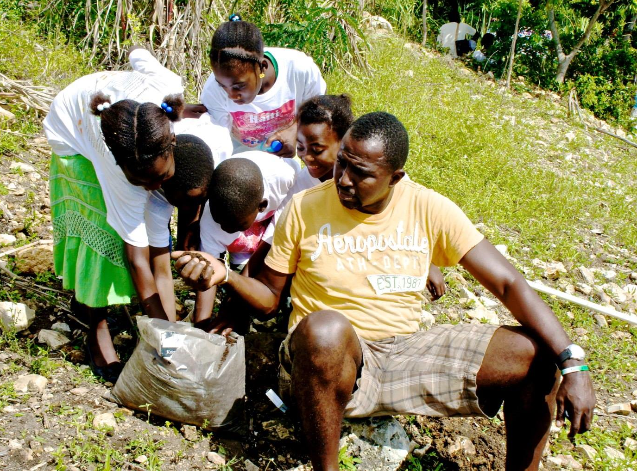
Phase 1: November- December 2013
Part I: Introduction of Moringa to Mare Brignol Community. (November 2013)
Education and Awareness: Planting and upkeep
Community Seminar
Social Marketing (Moringa Ambassadors)
Distribution of Educational Material
Implementation:
Planting of Community Gardens as future sources
Distribution of seeds and clippings among the community

Slide 3
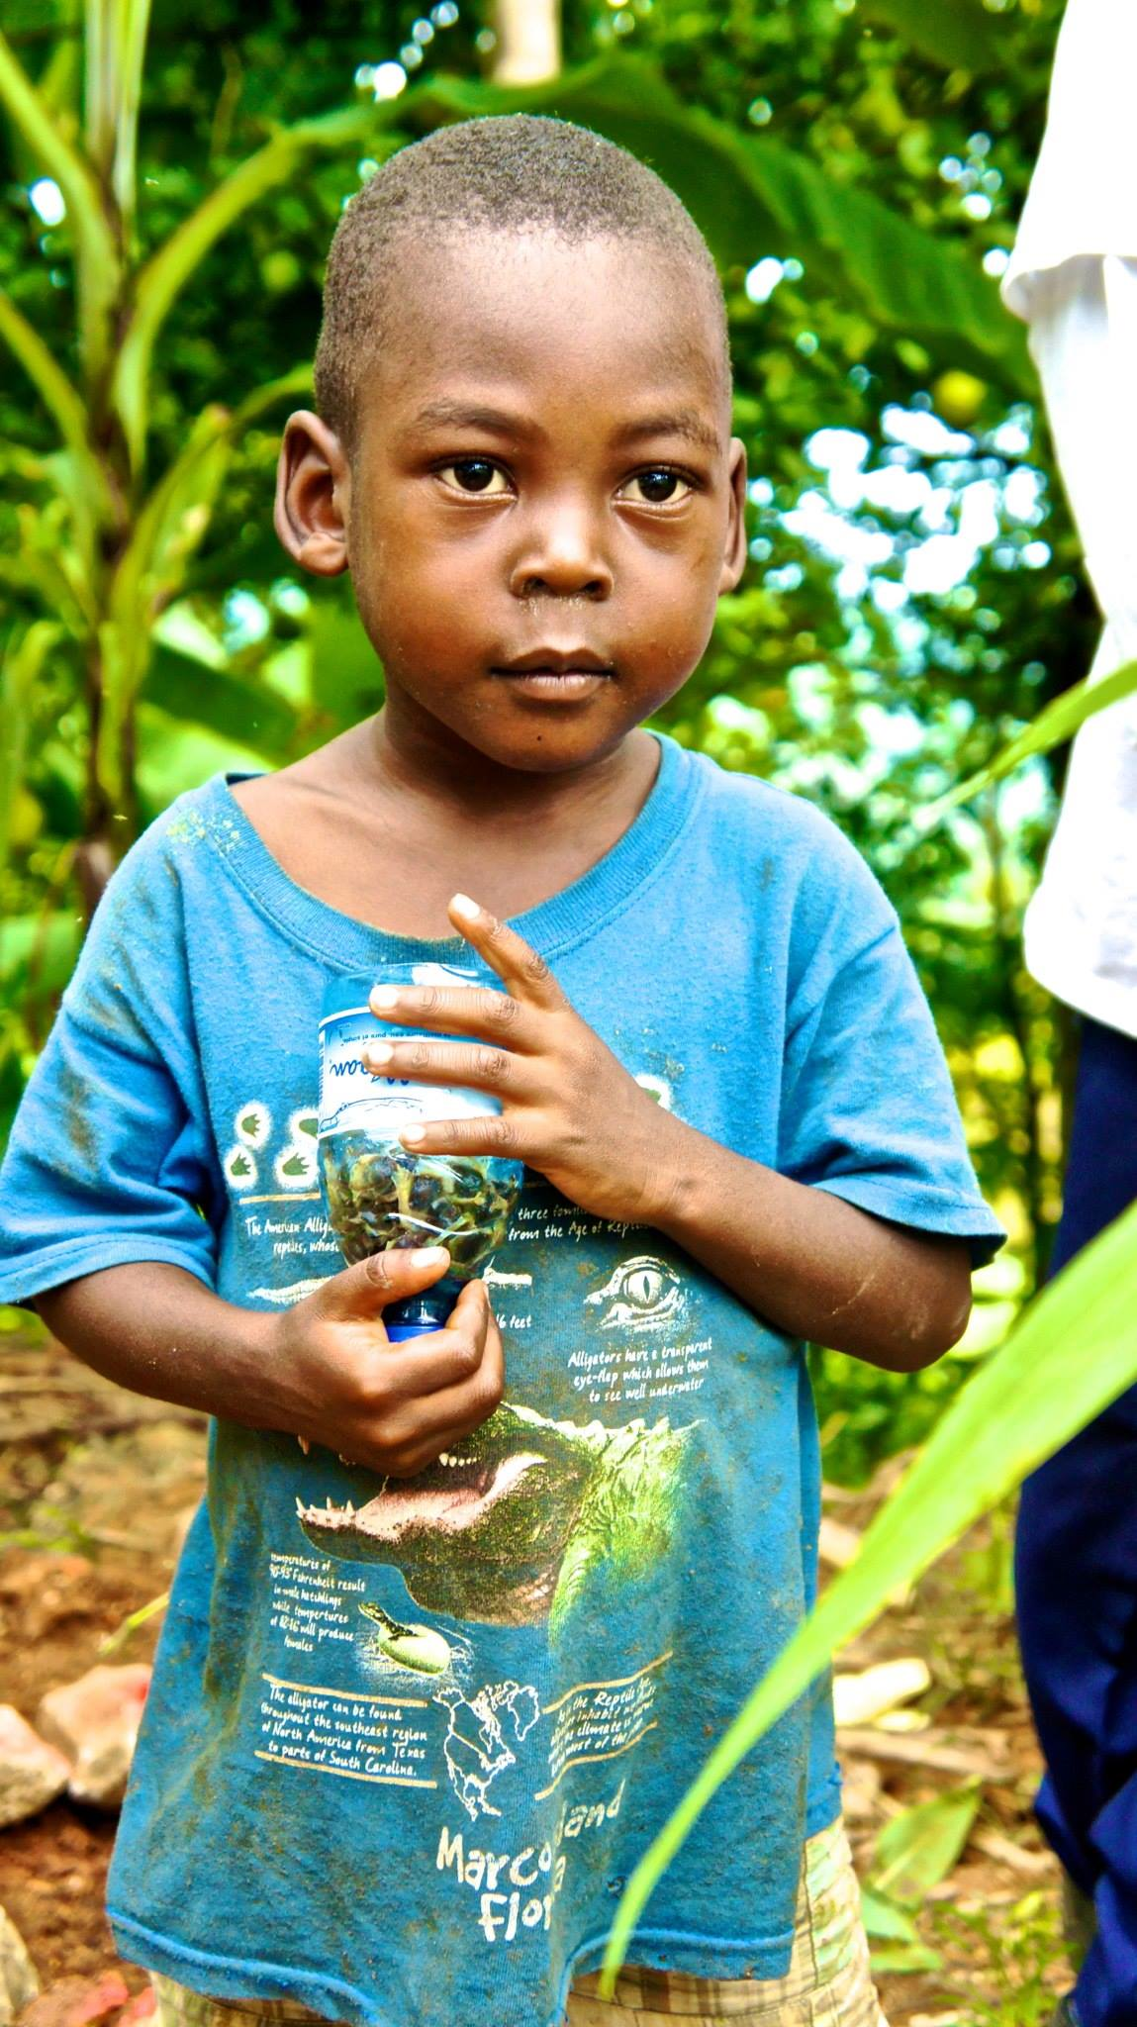
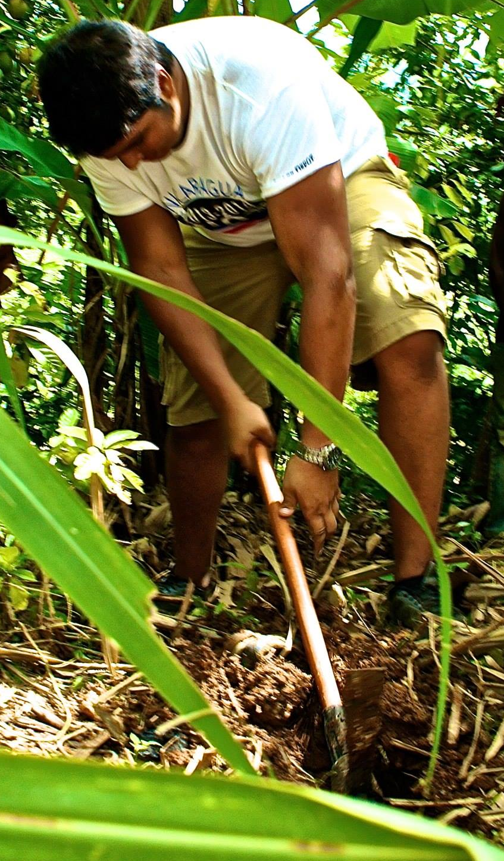
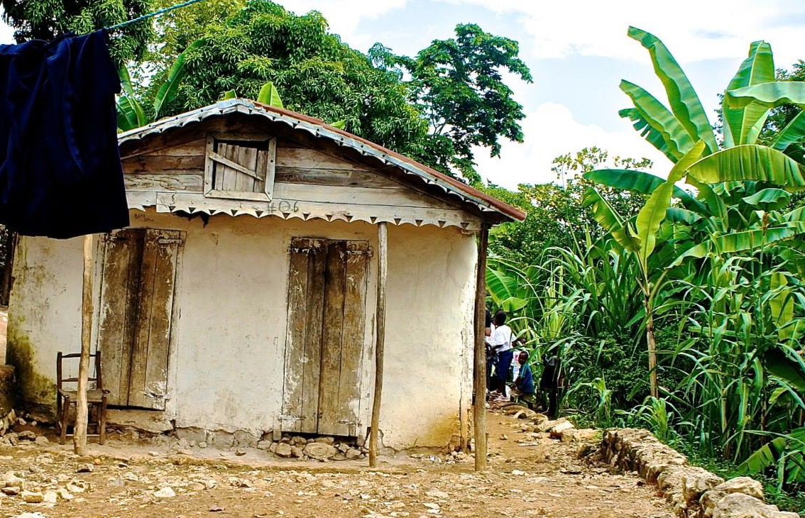
Phase 1: November- December 2013
Part II: Establishing baseline (December 2013)
Determining Population:
20 most accessible households (~100 individuals)
Collection of Baseline Data:
Full name, Age, Height/Weight, Vitals, Illnesses/Symptoms commonly suffered
Gauge effectiveness of previous Education: Planting and upkeep
In person interviews
Surveys
Implementation:
Planting 5-10 trees per household
Reinforcing information through personal education.
Deworming Program (Children 1-10)
Preventative and recuperative

Slide 4
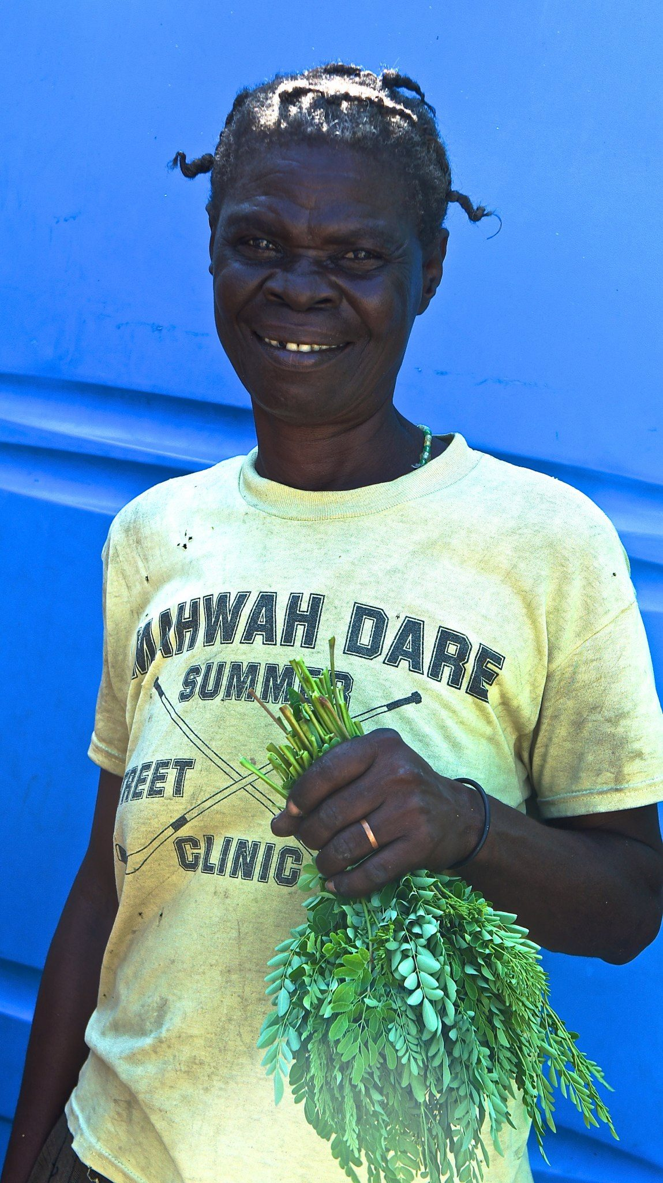
Phase 2: May 2014
Transition education or planting and upkeep towards consumption.
Collection of same baselines prior the start of consumption:
Comparison of data between December and May prior the start of consumption to measure changes unrelated to Moringa.
Propose Incentives for family with healthiest plants:
Creates motivation to continue growing and start consuming among the community.
Transition education towards consumption:
How to prune plant
How to consume
Dosage
Ways to consume
Drying leaves
Implementation:
Create more community gardens
Plant more in each household
Deworming Program (Children 1-10)
Preventative and recuperative

Slide 5
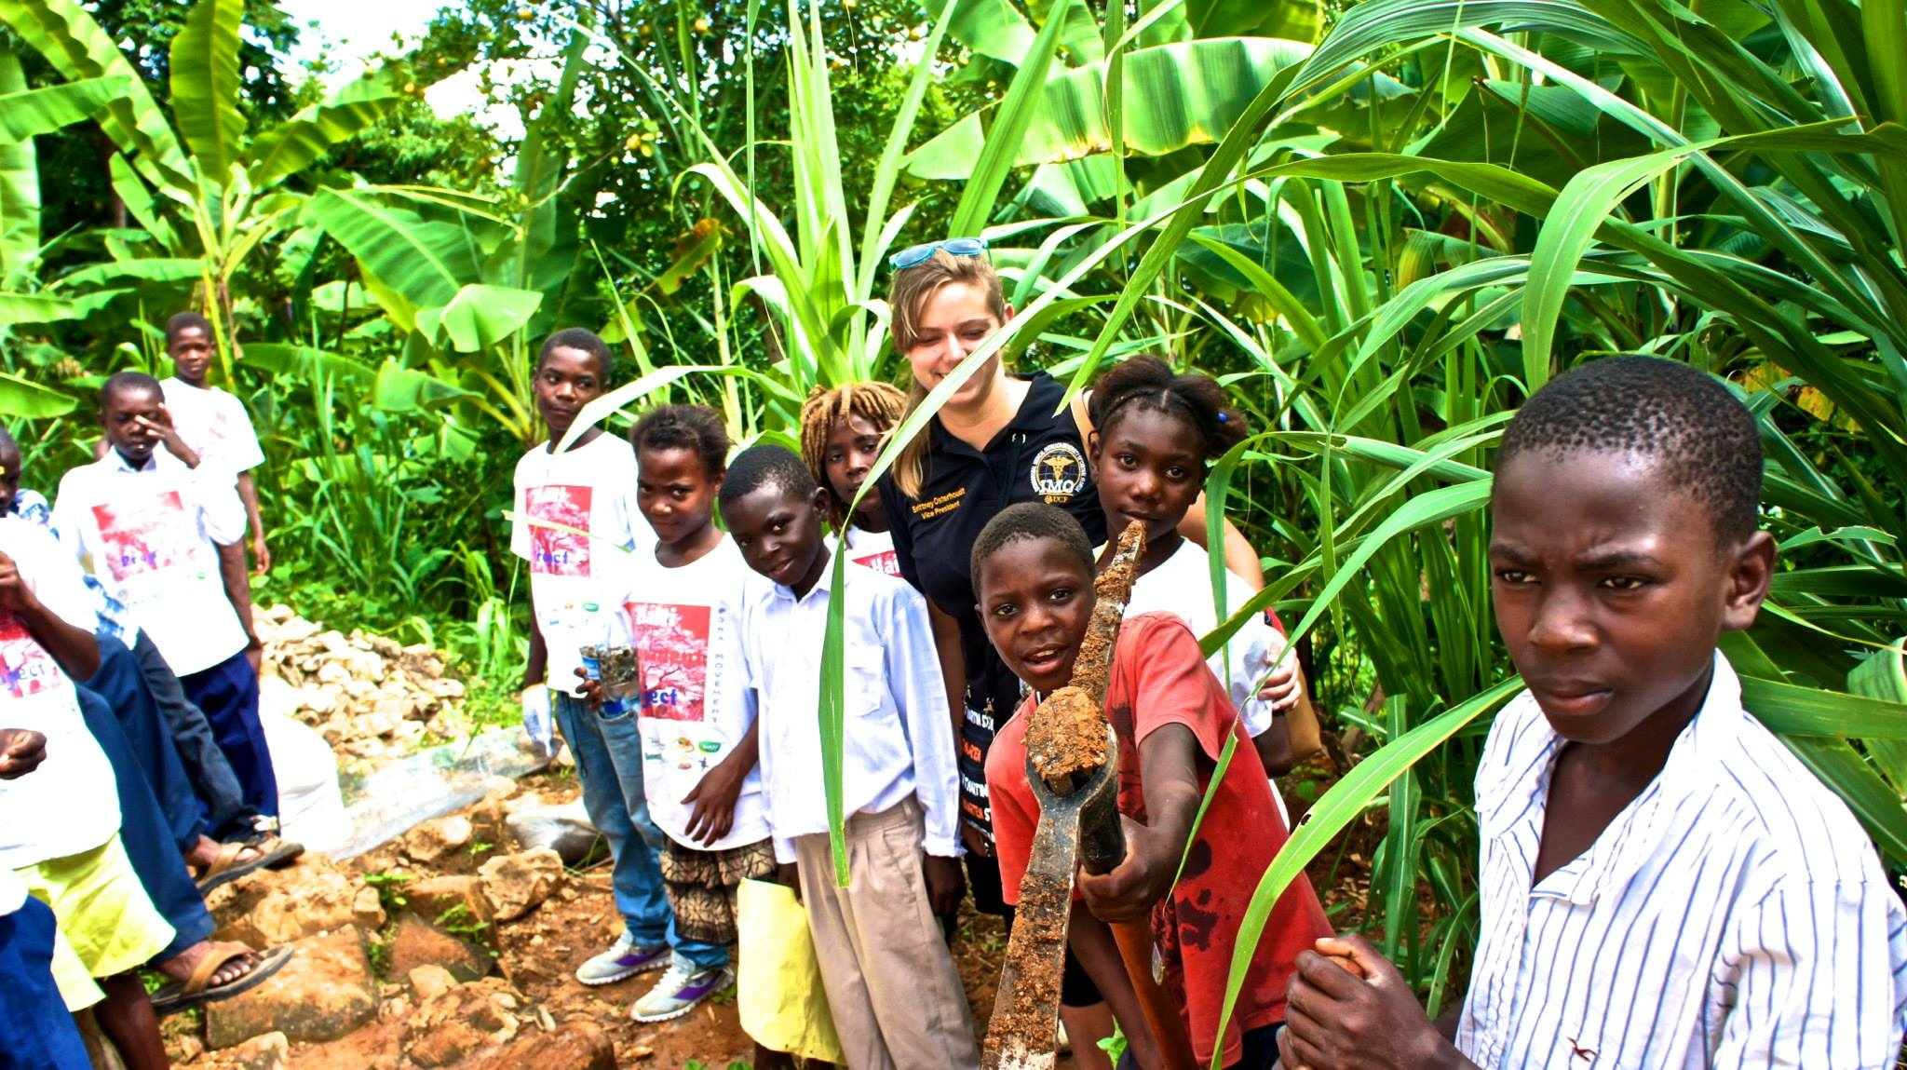
Phase 3: December 2014 – May 2015
Measure Impact of Moringa in Mare Brignol
Collection of data
6 and 12 months after consumption has begun.
Measure:
HAZ (Height/Age Z-scores)
WAZ (Weight/Age Z-scores)
BMI
Overall Health
Vitals
Symptoms reports
Continue Incentives for family with healthiest plants and with most health improvement:
Increase motivation to continue growing and consuming Moringa among the community.
Reinforce importance of consumption and previous education
Implementation:
Use of surveys to acquire data
Deworming Program (Children 1-10)
Preventative and recuperative

Slide 6
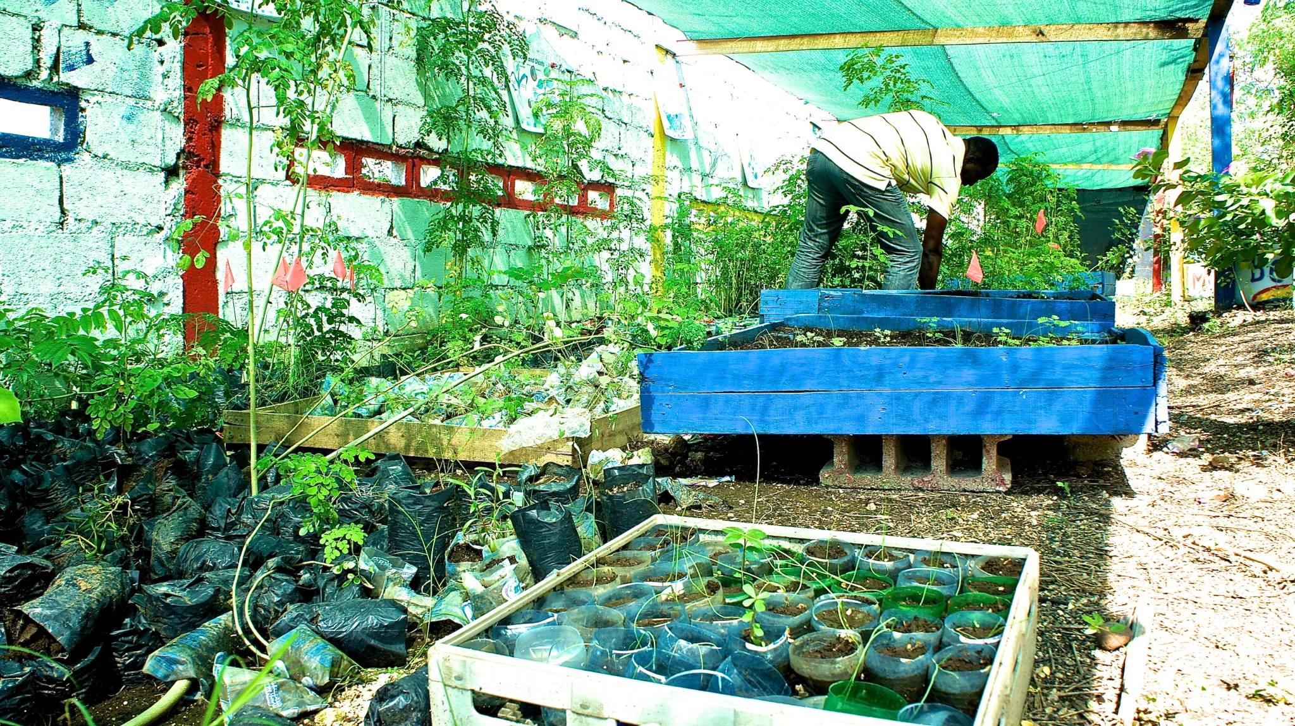
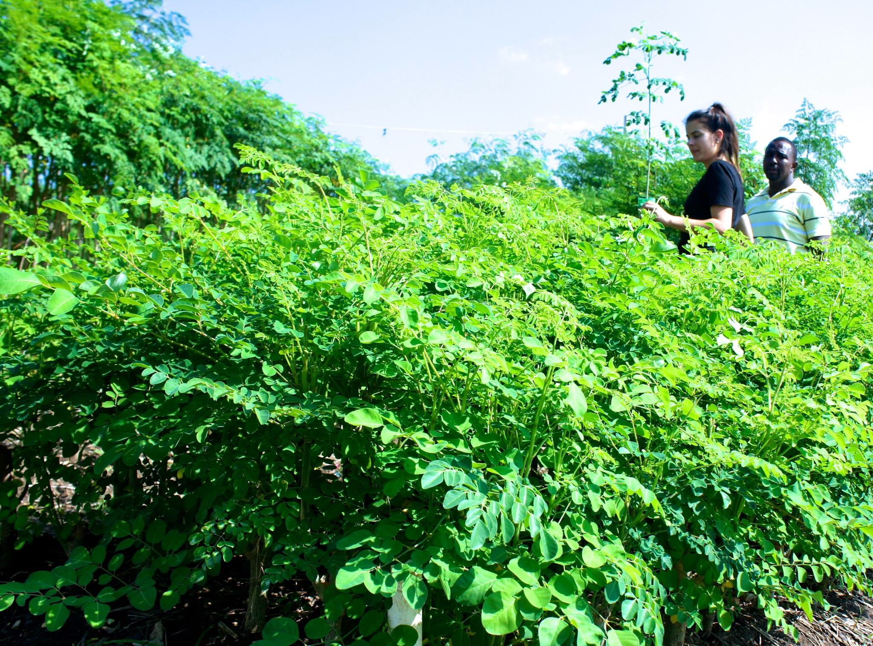
Future Goals
Continue Collection of Data and Education
Emulate Tap-Tap project
Expand to more Households
Create School Projects
Have enough trees and harvest to implement powder production
Create a micro-economy based on Moringa leaves/powder sales
Spread to adjacent communities
Become part of the Moringa Network

Slide 7
Methods to Gather Data
Surveys

